Slide 1
Object Oriented Programming (OOP)

Slide 2
Object-oriented programming (OOP) is a programming paradigm based on the concept of "objects".
The object contains both data and code:
Data in the form of properties (often known as attributes or state),
Code in the form of methods (actions an object can perform or behavior).
One important aspect of OOP in Python is to create reusable code using the concept of inheritance.
This concept is also known as DRY (Don't Repeat Yourself).
Notes:
procedural programming vs OOP
the problems are divided into several modules and solve accordingly.
makes the programming approach easy and maintenance of code is easy using the OOP concept.

Slide 3
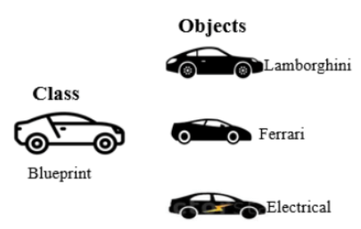
Class and Objects
In Python, everything is an object.
Class:
The class is a user-defined data structure that binds the data members and methods into a single unit.
Class is a blueprint or code template for object creation.
Using a class, you can create as many objects as you want.
Object:
An object is an instance of a class.
It is a collection of attributes (variables) and methods.
We use the object of a class to perform actions.

Slide 4
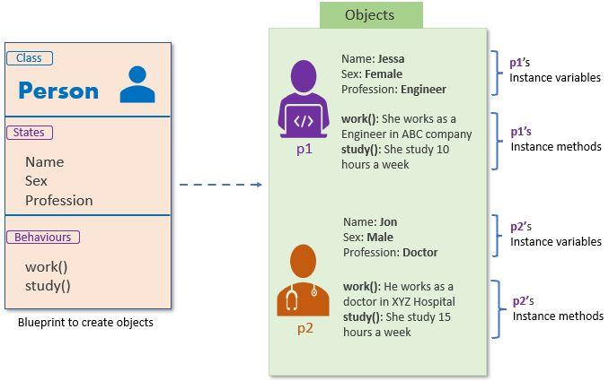
In short, Every object has the following property
Identity: Every object must be uniquely identified.
State: An object has an attribute that represents a state of an object, and it also reflects the property of an object.
Behavior: An object has methods that represent its behavior to modify its state or etc.

Slide 5
A real-life example of class and objects.
Class: Person
State: Name, Sex, Profession
Behavior: Working, Study
Using the above class, we can create multiple objects that depict different states and behavior.
Object 1: Jessa
State:
Name: Jessa
Sex: Female
Profession: Software Engineer
Behavior:
Working: She is working as a software developer at ABC Company
Study: She studies 2 hours a day
Object 2: Jon
State:
Name: Jon
Sex: Male
Profession: Doctor
Behavior:
Working: He is working as a doctor
Study: He studies 5 hours a day
As you can see, Jessa is female, and she works as a Software engineer. On the other hand, Jon is a male, and he is a doctor. Here, both objects are created from the same class, but they have different states and behaviors.

Slide 6
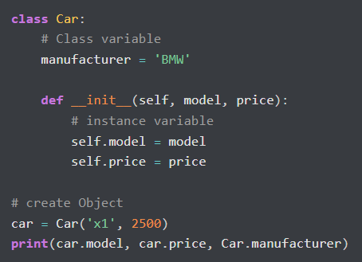
Now we will see some real example to start of classes and objects with variables.
There are several kinds of variables in Python:
Instance variables in a class: these are called fields or attributes of an object
Local Variables: Variables in a method or block of code
Parameters: Variables in method declarations
Class variables: This variable is shared between all objects of a class
Now when we design a class, we use instance variables and class variables.
Instance variables are declared inside a method using the self keyword

Slide 7
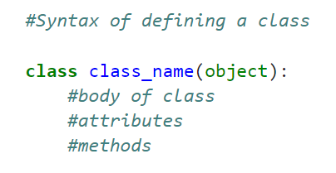
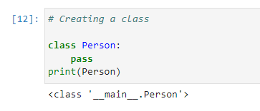
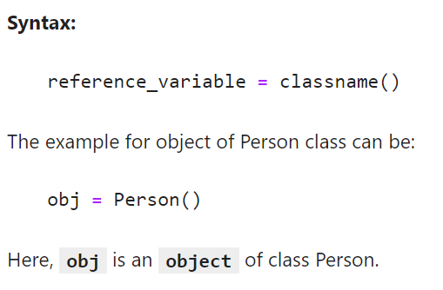
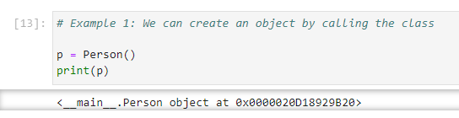
Now we will see some real example to start of classes and objects.

Slide 8
Instance Variable | Class Variable
Instance variables are not shared by objects. Every object has its own copy of the instance attribute | Class variables are shared by all instances and object.
Instance variables are declared inside the constructor i.e., the __init__() method. | Class variables are declared inside the class definition but outside any of the instance methods and constructors.
It is gets created when an instance of the class is created. | It is created when the program begins to execute.
Changes made to these variables through one object will not reflect in another object. | Changes made in the class variable will reflect in all objects.

Slide 9
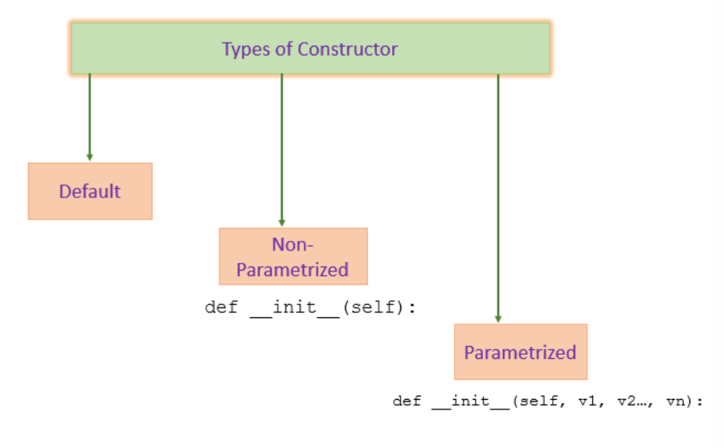

Slide 10
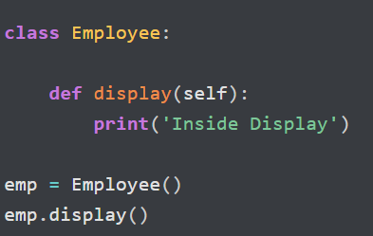
Default Constructor

Slide 11
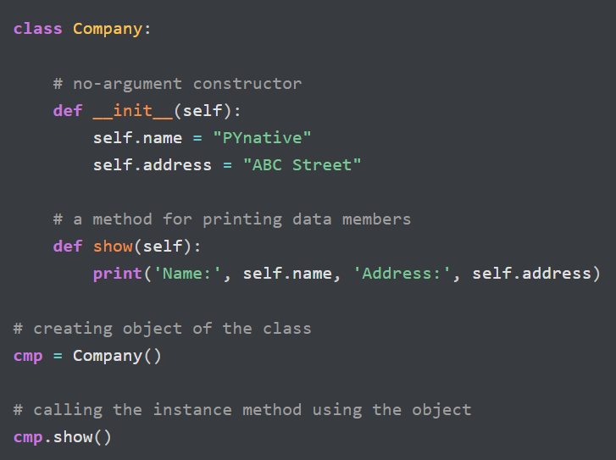
Non-Parametrized Constructor

Slide 12
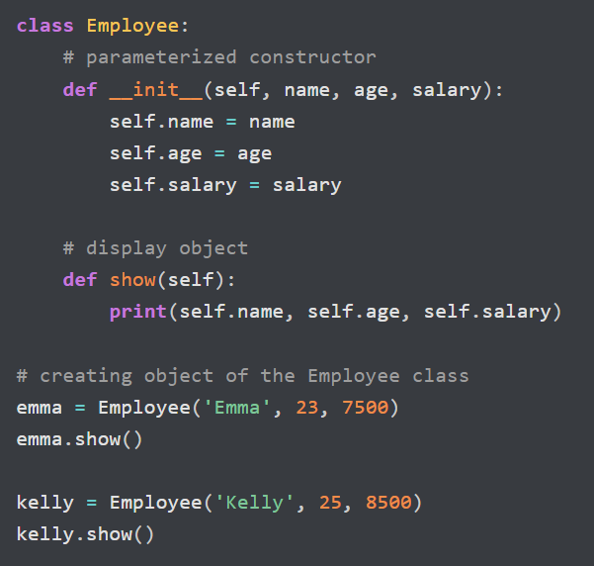
Parametrized Constructor

Slide 13
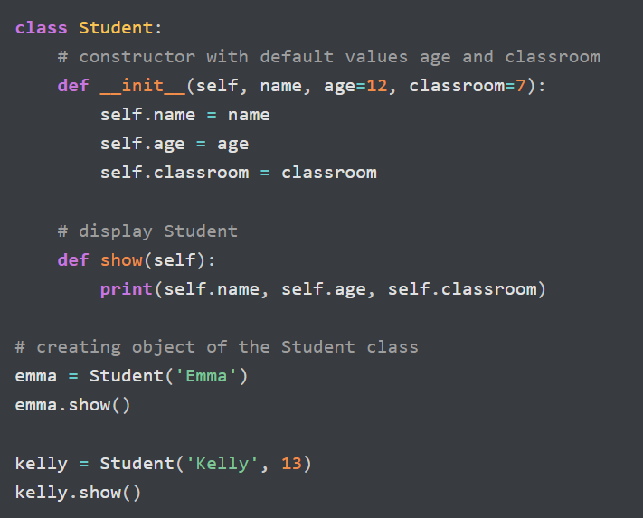
Constructor with default values (age and classroom)

Slide 14
Self Keyword in Python
We use self as the first parameter
Using self, we can access the instance variable and instance method of the object.
Whenever we call an instance method through an object, the Python compiler implicitly passes object reference as the first argument commonly known as self.
It is not mandatory to name the first parameter as a self. We can give any name whatever we like, but it has to be the first parameter of an instance method.

Slide 15
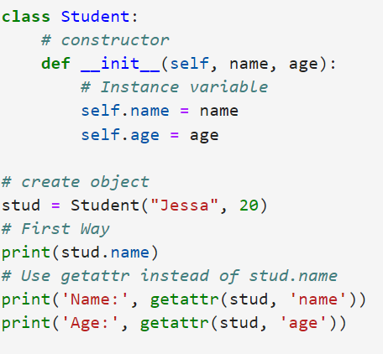
Ways to Access Instance Variable
There are two ways to access the instance variable of class:
Within the class in instance method by using the object reference (self) or name_object.name_Instance_Variable
Using getattr() method

Slide 16
task 1: OOP Building a Simple Statistics Class in Python
Task Overview:
Create a class called my_statistics that calculates basic statistics from a list of numbers. The class should include 4 methods:
count() → Returns the number of elements
sum() → Returns the total sum of elements
mean() → Returns the average value
median() → Returns the middle value
For example task 1:
ages = [31, 26, 34, 37, 27, 26, 32, 32, 26, 27]
Calc = my_statistics(ages)
Calc.count() ➝ returns 10
Calc.sum() ➝ returns 298
Calc.mean() ➝ returns 29.8
Calc.median() ➝ returns 29.0 >>> sorted()

Slide 17
task 2: OOP Voting System
Create a class to simulate a simple voting system with the following functions:
Function Name | Description
add_candidate(name) | Add a candidate to the election
show_candidates() | Display the list of all candidates
vote(name) | Add a vote to a candidate by name
get_results(name) | Return the total votes for a specific candidate
display_winner() | Show the candidate with the highest number of votes
Notes:
If the candidate doesn't exist, the system prints an error message.
Voting results and winner are displayed clearly.
You can expand the logic by adding voter ID tracking or duplicate vote prevention.
For example task 2 in a next slide

Slide 18
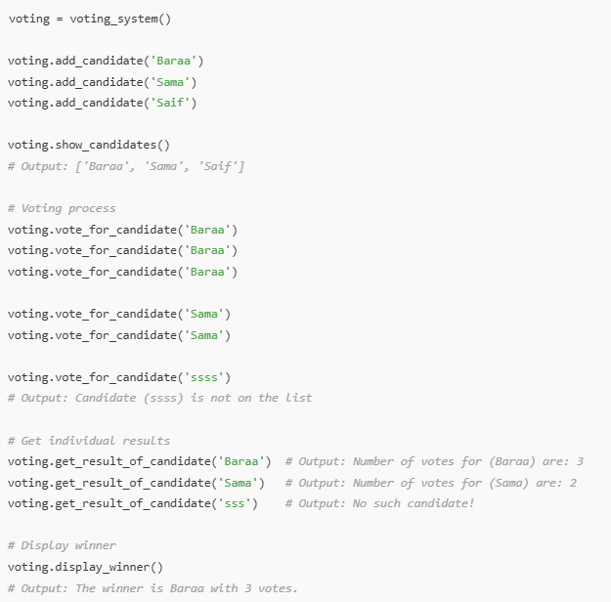
For example task 2:

Slide 19
There are four Pillars of Object Oriented Programming:
Abstraction
Encapsulation
Inheritance
Polymorphism
Lets try to understand each of them in a most easiest way!

Slide 20
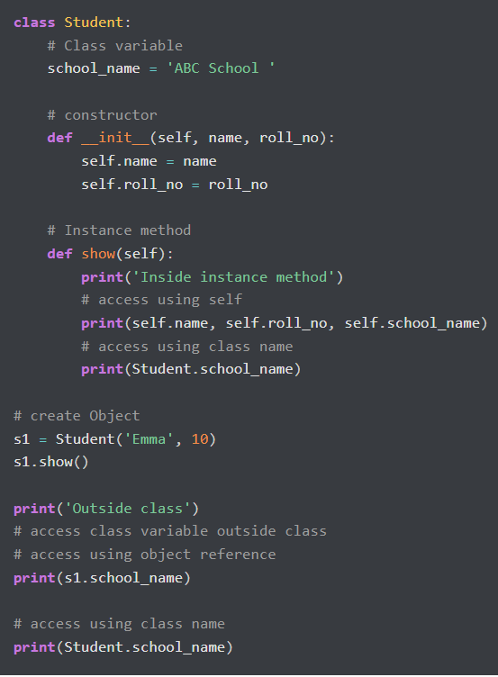
Ways to Accessing Class Variables
In Python, we can access the class variable in the following places
Access inside the constructor by using either self parameter or class name.
Access class variable inside instance method by using either self of class name
Access from outside of class by using either object reference or class name.

Slide 21
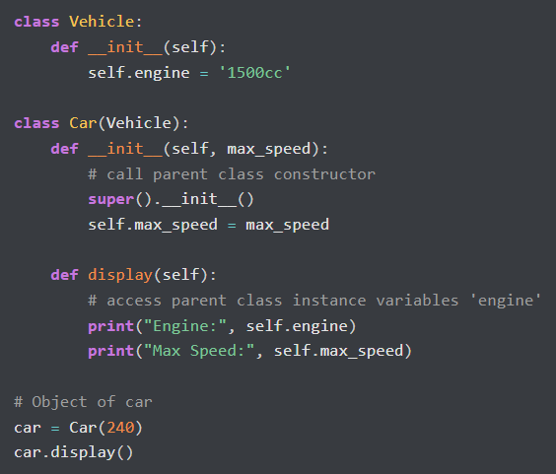
Access Instance Variable From Another Class
In Python, we can access the class variable in the following places
Access inside the constructor by using either self parameter or class name.
Access class variable inside instance method by using either self of class name
Access from outside of class by using either object reference or class name.

Slide 22
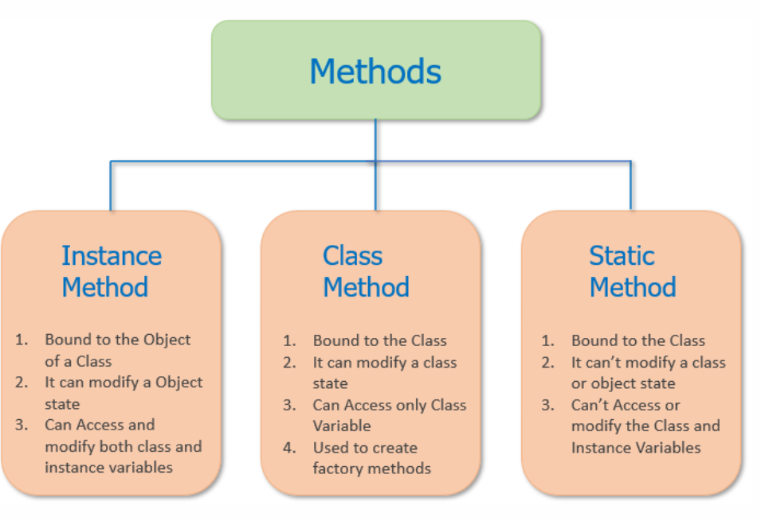

Slide 23
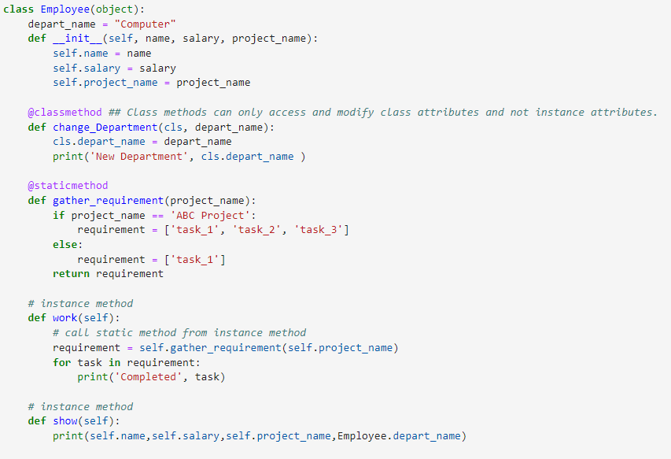
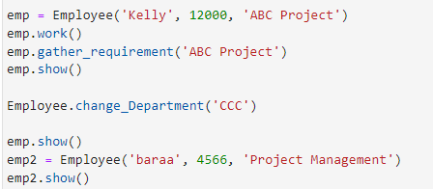
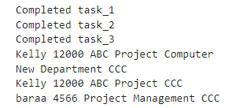

Slide 24
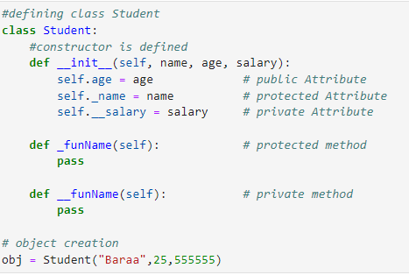
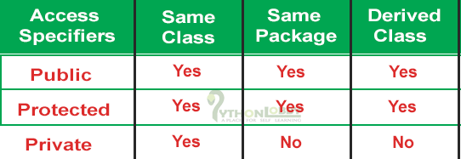
Access modifiers in Python Programming
To encapsulation
To implement proper encapsulation in Python,
we need to use setters and getters.
Notes:
مثال من الكود:
بالكود اللي شايفه بالصورة:
self.age هو متغير عام، يعني أي حد ممكن يوصل إله.
self._name هو متغير محمي، يعني بس الكلاس والكلاسات اللي بتشتق منه بتقدر توصل إله.
self.__salary هو متغير خاص، يعني بس داخل الكلاس "Student" نفسه.
يعني، التغليف بيحمي البيانات وبيتحكم بالوصول إلها، أما التجريد بيبسط الأمور وبيخفي التعقيد عشان تسهل التعامل مع الكود.

Slide 25
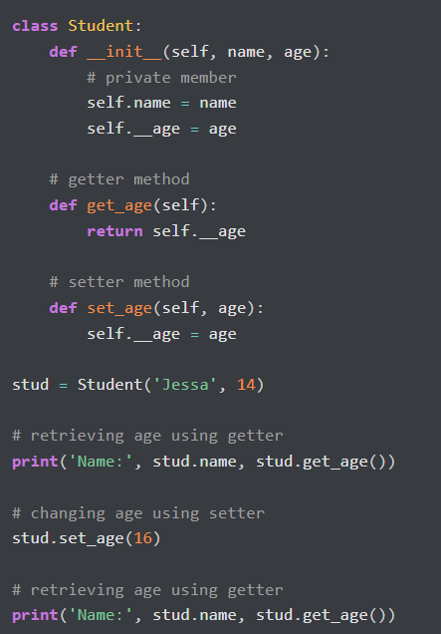
The getters and setters methods are often used when:
When we want to avoid direct access to private variables

Slide 26
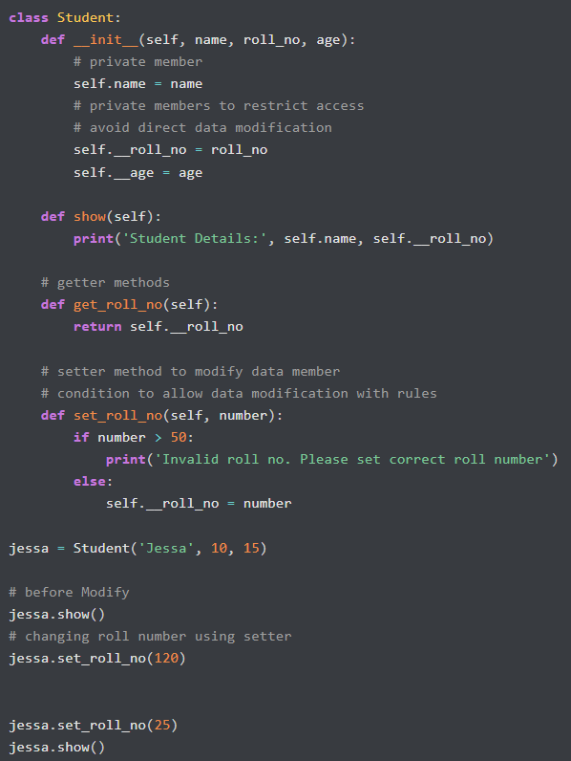
The getters and setters methods are often used when:
When we want to avoid direct access to private variables
To add validation logic for setting a value

Slide 27
Advantages of Encapsulation
Security: The main advantage of using encapsulation is the security of the data. Encapsulation protects an object from unauthorized access. It allows private and protected access levels to prevent accidental data modification.
Data Hiding: The user would not be knowing what is going on behind the scene. They would only be knowing that to modify a data member, call the setter method. To read a data member, call the getter method. What these setter and getter methods are doing is hidden from them.
Simplicity: It simplifies the maintenance of the application by keeping classes separated and preventing them from tightly coupling with each other.
Aesthetics: Bundling data and methods within a class makes code more readable and maintainable

